Slide 1

The Machine Learning Process
Why do some pandas commands end with parentheses?
Dr. Reza Dibaj

Slide 2
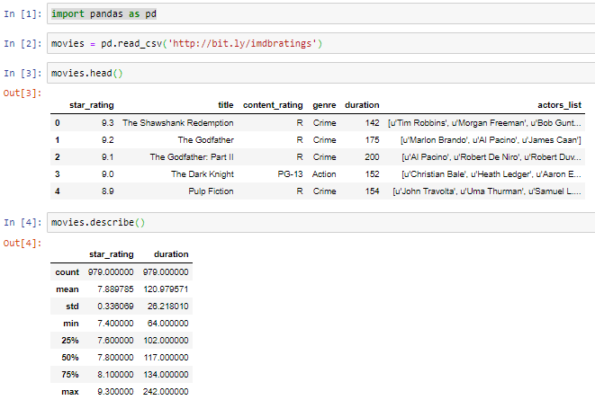
Starting with an Example
Let’s use an IMDB dataset, which is a CSV file that contains some top-rated movies.
Showing the statistics of all numeric columns
Notes:
import pandas as pd
movies = pd.read_csv('http://bit.ly/imdbratings’)
movies.head()
movies.describe()

Slide 3
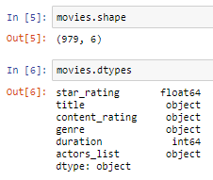
Starting with an Example
Unlike the previous commands, the following do not take any parenthesis.
Showing the number of row and columns of the dataset
Showing the datatypes of each columns
Notes:
import pandas as pd
movies = pd.read_csv('http://bit.ly/imdbratings’)
movies.head()
movies.describe()
movies.shape
movies.dtypes

Slide 4

Group Discussion
Please spend a few minutes with your team members and see what the deal is.

Slide 5


Discussion Summary
movies is a DataFrame object and each object could have number of methods and attributes.
Methods use parentheses and could have (required or optional) arguments
More of actions
Attributes have no parentheses
More of descriptions
In pandas we mostly have either DataFrame methods/attributes or Series methods/attributes.
Notes:
Actions: What you do, e.g. reza.walk() or reza.talk(toMe)
Attributes: Who you are e.g. reza.height or reza.age

Slide 6
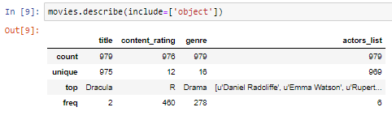
Methods with Arguments
Let’s try describe with an optional argument:
It shows the statistics for the object type columns
Notes:
import pandas as pd
movies = pd.read_csv('http://bit.ly/imdbratings’)
movies.head()
movies.describe()
movies.shape
movies.dtypes
movies.describe(include=['object’])

Slide 7

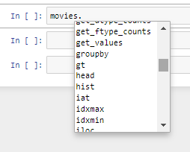
How to get the list of methods and attributes?
Please type your object name, e.g. movies and the dot and then hit the Tab button…

Slide 8
Functions vs Methods
Functions: Generally, the actions in pandas which have come from the libraries
e.g. pd.read_csv()
Methods: the actions that are attached objects
e.g. movies.head()

Slide 9

Bonus Tip
In any method or function to know the arguments, click anywhere between the parentheses and hit Shift + Tab
Hitting Shift + Tab for once → small window
Hitting Shift + Tab for twice → bigger window
Hitting Shift + Tab for 3 times → window with the same size but for longer period
Hitting Shift + Tab for 4 times → Half of the screen window

Slide 10
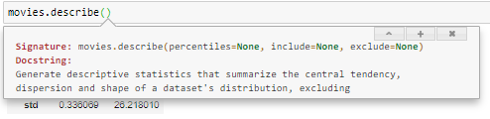
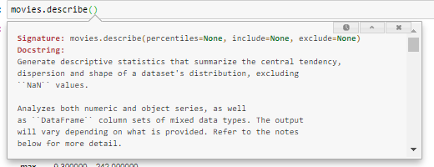
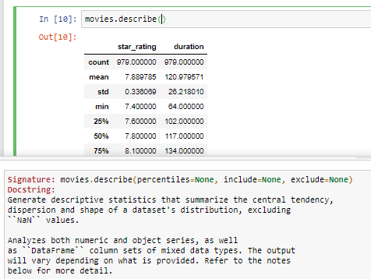
Bonus Tip (Only works in Jupyter)
1 Shit + Tab
2 or 3 Shit + Tab
4 Shit + Tab

Slide 11

Thank you
Question?
To be
Not to be

